Slide 1


Start Smart 1.0
3RD Grade
Lesson 8

Slide 2

ELD Objective
ELD Objective: Students will be able to engage in a Constructive Conversation using the Constructive Conversation Skill of FORTIFY, by taking turns, sharing ideas and making ideas clearer with a partner based on a visual text.

Slide 3
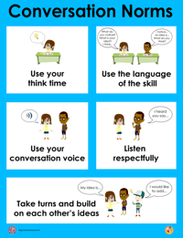
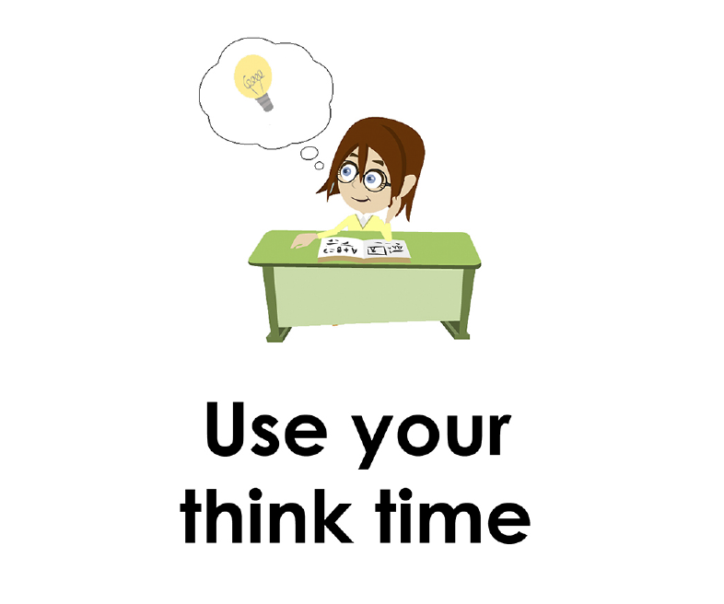
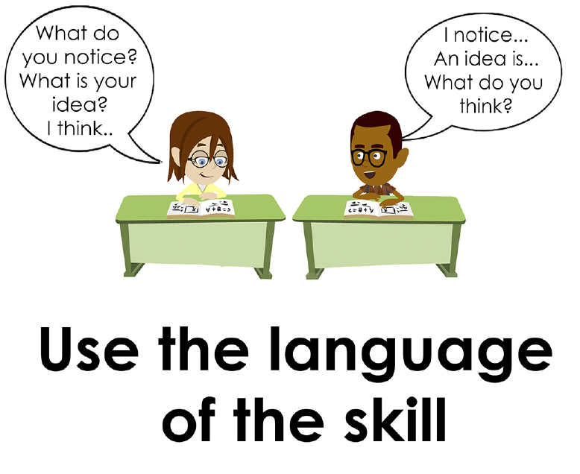
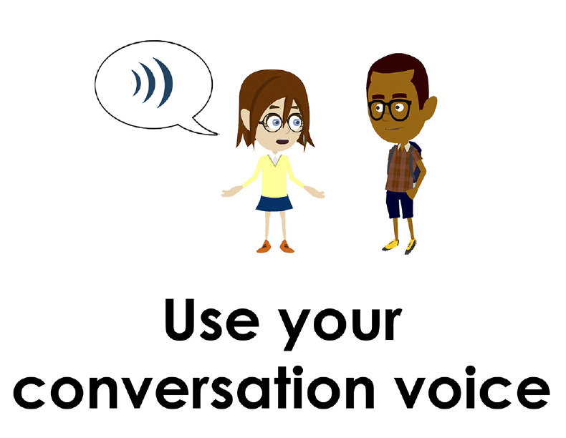
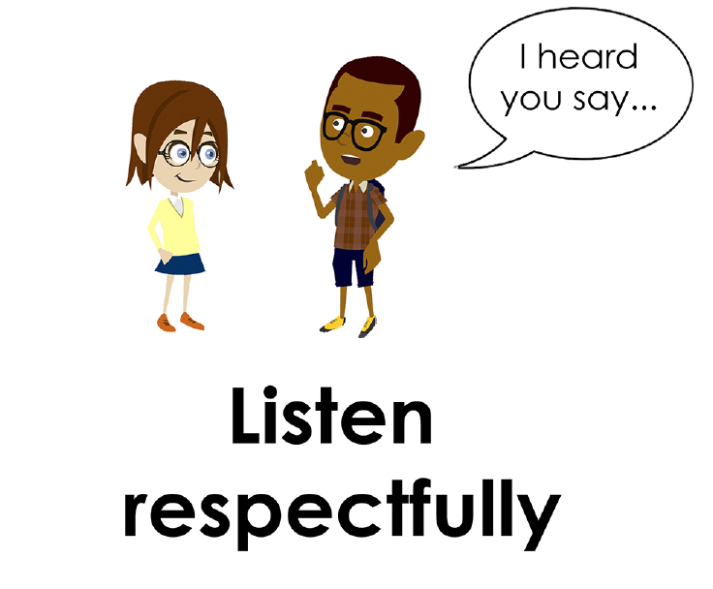
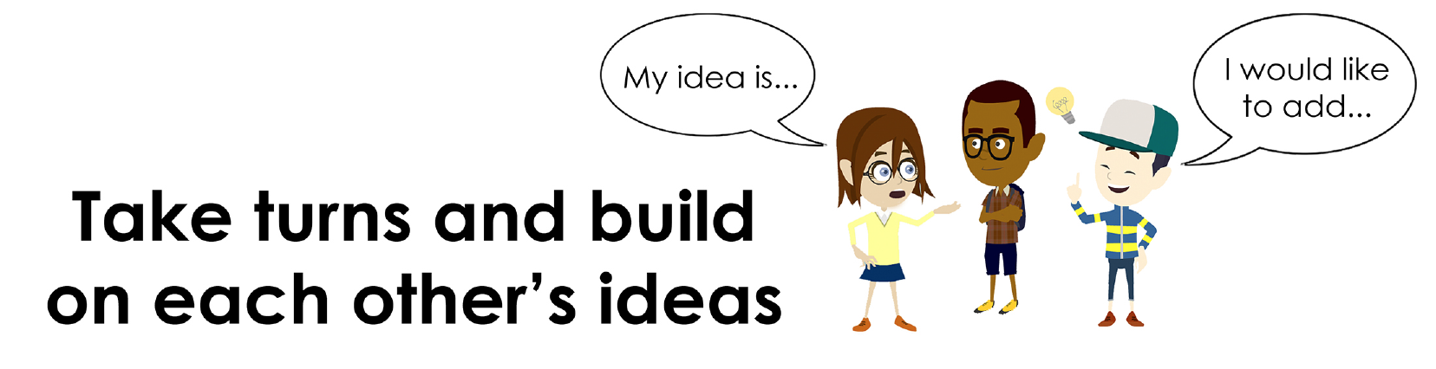
Conversation Norms Poster
  Use your think time
  Use the language of the skill
  Use your conversation voice
  Listen respectfully
  Take turns and build on each other’s ideas

Slide 4
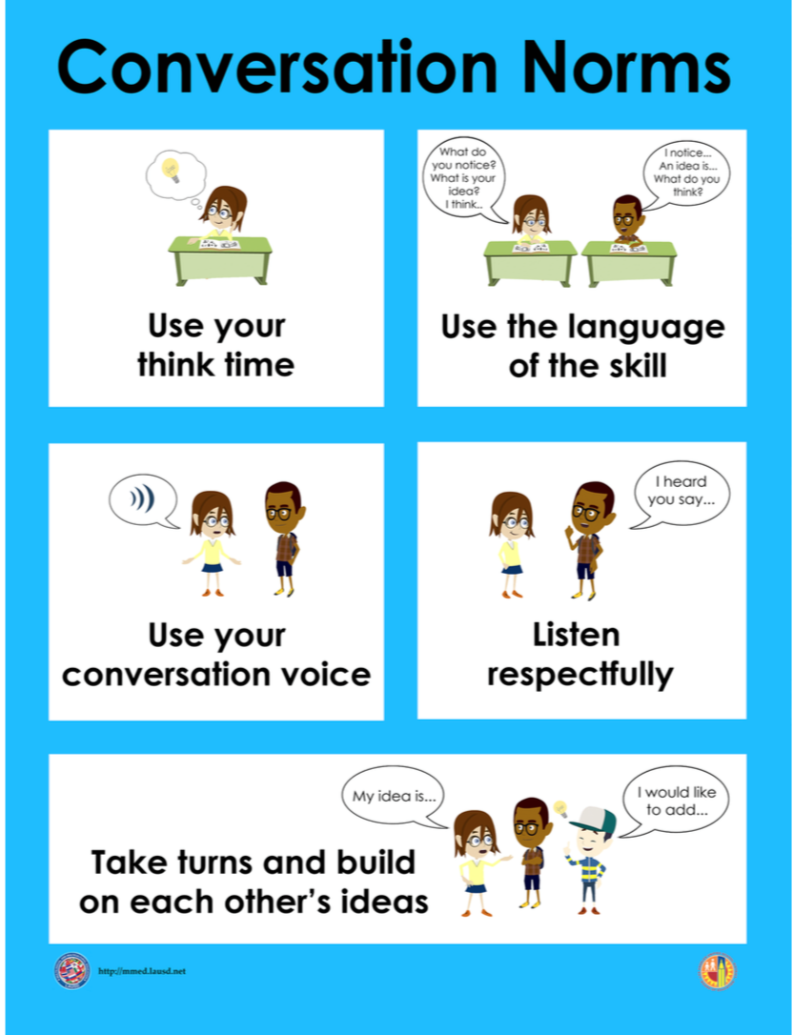
Notes:
The focus today is:
Use your think time
Use the language of the skill

Slide 5
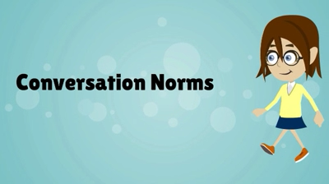
Conversation Norms
Notes:
Show Constructive Conversation Norms Video as a review of all norms

Slide 6
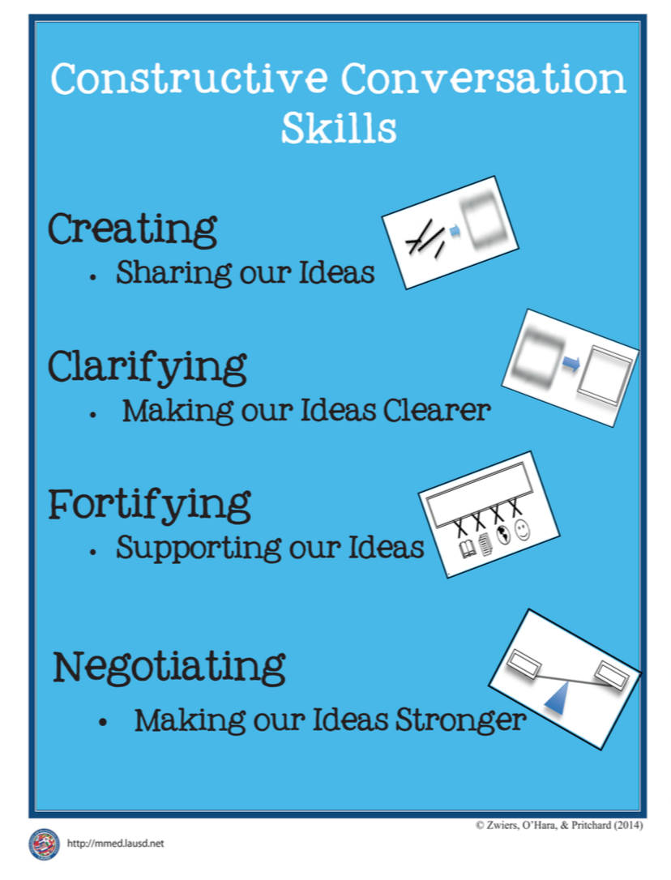
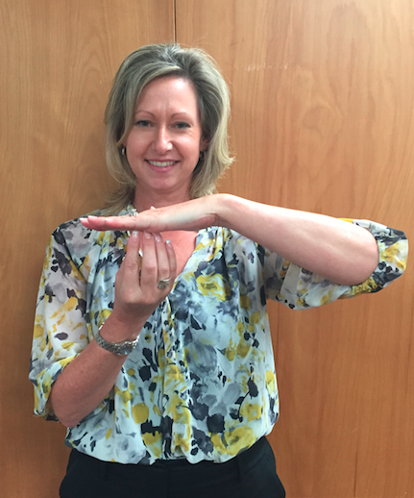
Hand Gesture and Phrase- FORTIFY
Supporting Our Ideas
Notes:
Model FORTIFY and have participants repeat with you:
Place hand, palm down in front of you as if putting an idea on the table. Use four fingertips of the other hand to support the palm.

Slide 8
Prompt:
What is happening in this visual text? Provide evidence from the text to support your claim.
TEACHER VISUAL TEXT

Slide 9


Listen to the Model Constructive Conversation
  Use your think time to study the visual text.
Listen actively to what two partners say to each other.
Notes:
Provide a copy of the Model Script to the volunteer and allow time beforehand for student to review the script. Suggestions for reading the script:
● Show a video of students having the model conversation (optional)
● Student volunteer and teacher read model script
STUDENT LISTEN ACTIVELY

Slide 10
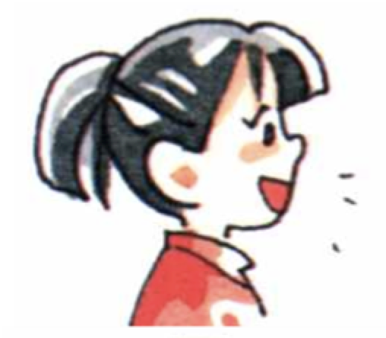
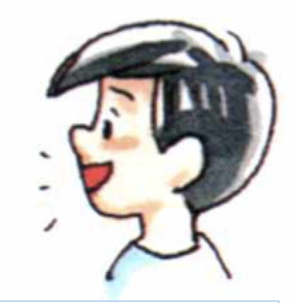
Visual Text Model
What is happening in this visual text. Provide evidence from the text to support your claim.
Partner A: What is happening is that all the kids are bringing different items to the girl with the red hair. What do you think is happening?
Partner A:I notice that the big boy is carrying a shelf, another boy is carrying a sign that reads “Amanda’s Fine Pies” and the little boy is bringing two buckets of fruit. What evidence do you have?
Partner A:I think they are all bringing her items she needs to bake pies. What other evidence do you have?
Partner A: What is happening is that Amanda is baking pies and all the kids are bringing items to help her.
Partner B:I think that she is making pies and the others are helping her. What evidence do you have?
Partner B: I know that they are baking pies because in the text, the boy is holding a sign that says “Amanda’s Pies.” I think the girl’s name is Amanda because she’s the one making the pies. The girl also has a rolling pin and dough on the table. What evidence do you have?
Partner B: I know because the little boy is bringing her some kind of fruit in the buckets. He is raising one of the buckets to Amanda. What evidence to you have?
Partner B: Based on the evidence from the text, I think Amanda is baking pies to sell. I think that is why the boy is carrying a sign. They need it to advertise the pies for sale and the others are helping Amanda to prepare for the bake sale.

Slide 12
Listen to the Non-Model Constructive Conversation
  Use your think time to study the visual text.
Listen actively to what two partners say to each other.
Notes:
Provide a copy of the Non-­‐‑Model Script to the volunteer and allow time beforehand for student to review the script. Suggestions for reading the script:
● Show a video of students having the model conversation (optional)
● Student volunteer and teacher read model script
STUDENT LISTEN ACTIVELY

Slide 13
Visual Text Non- Model
What is happening in this visual text. Provide evidence from the text to support your claim.
Partner A: I notice a girl with red hair. What do you see?
Partner A: There is a girl with red hair. What do you notice?
Partner A: In the visual text, there are 3 more pieces of masa.
Partner A: I also see a boy with a red shelf.
Partner B: There’s a sign that says “Amanda’s Pies.”
Partner B: The girl in the pink shirt is eating the flat cookie.
Partner B: I see a kid with two buckets of fruit.
Partner B: Let’s put our ideas together. We like pies.

Slide 14

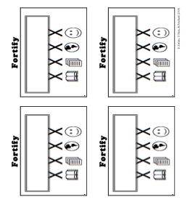
Constructive Conversation Game
PROMPT:
What is happening in this visual text? Provide evidence from the text to support your claim.
Rules of the game:
Each of you needs 1 CREATE, 2 CLARIFY and 3 FORTIFY cards
Each of you will play one card as you share your CREATE, CLARIFY and FORTIFY ideas. You will continue taking turns until all cards are placed in the middle.
If you’re done early repeat the process for an additional round.
Remember to use the Constructive Conversation Norms and Skills as you play the game.
Notes:
You are now going to have the opportunity to practice the Constructive Conversation Skill FORTIFY while playing a game.
Explain the rules of the Constructive Conversation Game to students.

Slide 15
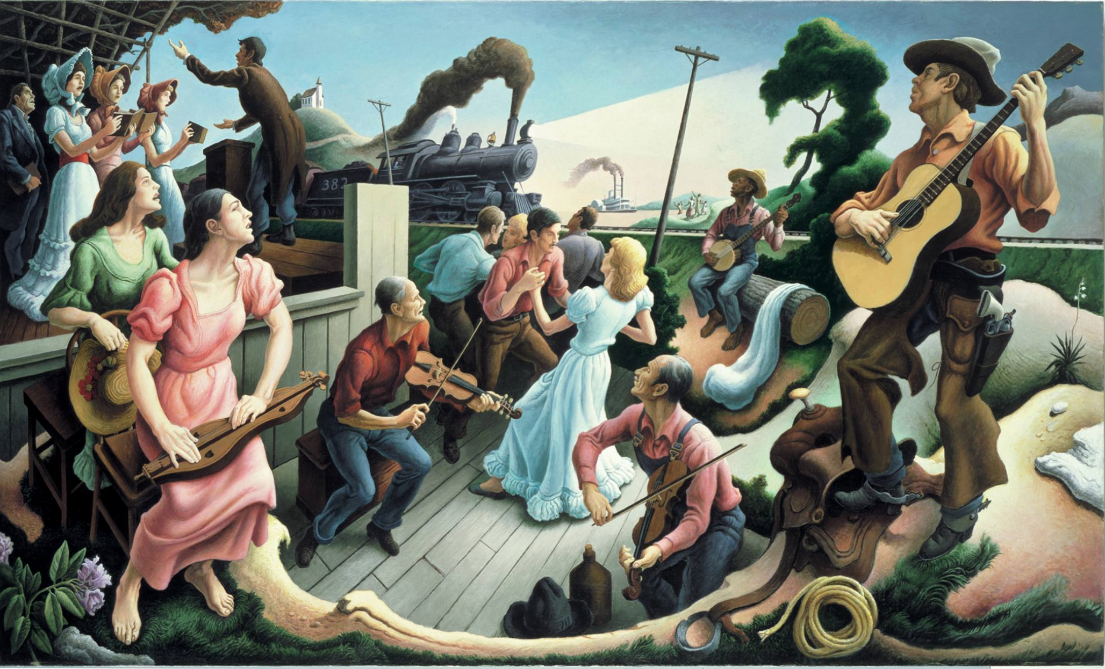

Prompt: What is happening in this visual text? Provide evidence from the text to support your claim.
TEACHER COLLECTS LANGUAGE SAMPLE SPF 1.0
STUDENT VISUAL TEXT
Notes:
Display the Student Visual Text
Direct students to use their Think Time
As the students play the game, the teacher listens and selects two students who will replay the game in front of the class to serve as models.
This is an opportunity to capture a language sample.

Slide 16


CONSTRUCTIVE CONVERSATION
FISHBOWL MODEL
PROMPT: What is happening in this visual text. Provide evidence from the text to support your claim.
Listen actively to what two partners say to each other.
FORMATIVE ASSESSMENT– TEACHER COLLECTS LANGUAGE SAMPLE SPF 1.0
Notes:
The two selected students will replay the game in front of the class and serve as models.
Student Progress Form (SPF)-­‐‑ Constructive Conversation Language Sample The teacher will collect a language sample from the two students on the Student Progress Form (SPF)-­‐‑ Constructive Conversation Language Sample to be used in Lesson 2. The language sample must be at least four turns in length. (Each turn includes both Partner A and B sharing

Slide 17
WRAP-UP
How did we meet today’s objective of using the Constructive Conversation Skill of FORTIFY?
How did you:
    Use your think time?
    Use the language of the skill
  Work with your conversation partner to do the following:
    Identify three things that you did to meet today’s objective
    Share and explain the three things to your partner
Notes:
Teacher will review ELD objective.
Today we engaged in a Constructive Conversation using the Constructive Conversation Skill-­‐‑FORTIFY. We took turns and shared ideas based on a visual text.
Teacher will ask students the following:
● How did we meet today’s objective of using the Constructive Conversation Skill of FORTIFY?
● How did you:
-Use your think time
-Use the language of the skill
● Work with your conversation partner to do the following:
Identify three things that you did to meet today’s objective
Share and explain the three things to your partner
Teacher calls on three students and they tell the class what was done today.

Slide 18
Start Smart 1.0
FORTIFY
3RD Grade
Lesson 9

Slide 19
ELD Objective
Students will be able to revise a Non-Model Conversation for the Constructive Conversation Skill- FORTIFY in a whole group setting and with a triad.
Notes:
Today we are going to review the Constructive Conversation Skill-­‐‑FORTIFY. When we create, we say what we notice about something.

Slide 20
Notes:
Let’s review the Conversation Norms Poster
Today, we will focus on:
Use the language of the skill
Use your conversation voice
**Give examples for both. Ask for student volunteers to model the two norms.

Slide 21
Conversation Norms
Notes:
Show Constructive Conversation Norms Video as a review of all norms

Slide 22
Hand Gesture and Phrase- FORTIFY
Supporting Our Ideas
Notes:
Model FORTIFY and have participants repeat with you:
Place hand, palm down in front of you as if putting an idea on the table. Use four fingertips of the other hand to support the palm.

Slide 23
Prompt and Response Starters
Prompt Starters:
How do you know…?
What is happening…?
Where did you get that information?
Show me in the text where…
Response Starters:
I know because…
I think ____, so____...
I have seen this in…
In the text…

Slide 25
Prompt:
What is happening in this visual text? Provide evidence from the text to support your claim.
TEACHER VISUAL TEXT
Notes:
Display the Student Visual Text
Direct students to use their Think Time

Slide 26
Listen to the Model Constructive Conversation
  Use your think time to study the visual text.
Listen actively to what two partners say to each other.
Notes:
Provide a copy of the Model Script to the volunteer and allow time beforehand for student to review the script. Suggestions for reading the script:
● Show a video of students having the model conversation (optional)
● Student volunteer and teacher read model script
STUDENT LISTEN ACTIVELY

Slide 27
What makes this a model conversation?
Partner A: What is happening is that all the kids are bringing different items to the girl with the red hair. What do you think is happening?
Partner A:I notice that the big boy is carrying a shelf, another boy is carrying a sign that reads “Amanda’s Fine Pies” and the little boy is bringing two buckets of fruit. What evidence do you have?
Partner A:I think they are all bringing her items she needs to bake pies. What other evidence do you have?
Partner A: What is happening is that Amanda is baking pies and all the kids are bringing items to help her.
Partner B:I think that she is making pies and the others are helping her. What evidence do you have?
Partner B: I know that they are baking pies because in the text, the boy is holding a sign that says “Amanda’s Pies.” I think the girl’s name is Amanda because she’s the one making the pies. The girl also has a rolling pin and dough on the table. What evidence do you have?
Partner B: I know because the little boy is bringing her some kind of fruit in the buckets. He is raising one of the buckets to Amanda. What evidence to you have?
Partner B: Based on the evidence from the text, I think Amanda is baking pies to sell. I think that is why the boy is carrying a sign. They need it to advertise the pies for sale and the others are helping Amanda to prepare for the bake sale.

Slide 28
Understanding the Skill of FORTIFY
Partner A: What is happening is that all the kids are bringing different items to the girl with the red hair. What do you think is happening?
Partner A:I notice that the big boy is carrying a shelf, another boy is carrying a sign that reads “Amanda’s Fine Pies” and the little boy is bringing two buckets of fruit. What evidence do you have?
Partner A:I think they are all bringing her items she needs to bake pies. What other evidence do you have?
Partner A: What is happening is that Amanda is baking pies and all the kids are bringing items to help her.
Partner B:I think that she is making pies and the others are helping her. What evidence do you have?
Partner B: I know that they are baking pies because in the text, the boy is holding a sign that says “Amanda’s Pies.” I think the girl’s name is Amanda because she’s the one making the pies. The girl also has a rolling pin and dough on the table. What evidence do you have?
Partner B: I know because the little boy is bringing her some kind of fruit in the buckets. He is raising one of the buckets to Amanda. What evidence to you have?
Partner B: Based on the evidence from the text, I think Amanda is baking pies to sell. I think that is why the boy is carrying a sign. They need it to advertise the pies for sale and the others are helping Amanda to prepare for the bake sale.
Notes:
Understanding the Skill: Fortify
Teacher displays or distributes the Model Script from Lesson 8.
Let’s look at the Model Script to find evidence of the skills of CREATE, CLARIFY and FORTIFY. How are we using the visual text to guide our conversation?
Example of Think-Aloud:
Student A:
What is happening is CR that all the kids are bringing different items to the girl with the red hair. CL What do you think is happening?
Student B:
I think that CR she is making pies and the others are helping her. What evidence do you have? F
Student A:
I notice that the big boy is carrying a shelf, another boy is carrying a sign that reads “Amanda’s Fine Pies” and the little boy is bringing two buckets F of fruit. What evidence do you have? F
Student B:
I know that they are baking pies because F in the text, the boy is bringing a sign that says “Amanda’s Pies.” I think the girl’s name is Amanda because she’s the one making the pies. The girl also has a rolling pin and dough on the table. What evidence do you have? F
Let’s look at the first set of turns. Read it to yourself as I read it aloud (see example above).
Let’s look at the language of the skill. Look at Student A’s response. How do I know Student A used the skill of FORTIFY? I notice the language of the skill (underline as noted above).
I know this is FORTIFY because it is asking for evidence from the text so I will label it with F (Write F next to the response.) I also notice that Student B is using the language of the skill to answer a FORTIFY question to provide evidence, so I will label it with F (Write F next to the response and underline as noted above). Student A responds with the language of the skill FORTIFY (underline as noted above). Also, they provide more evidence, based on what is in the visual text.
Teacher prompts student pairs to go through the same process with the rest of the Model Conversation. Students may share their responses in a whole group discussion led by the teacher.

Slide 30
Listen to the Non-Model Constructive Conversation
  Use your think time to study the visual text.
Listen actively to what two partners say to each other.
Notes:
Provide a copy of the Non-Model Script to the volunteer and allow time beforehand for student to review the script. Suggestions for reading the script:
● Show a video of students having the model conversation (optional)
● Student volunteer and teacher read model script
STUDENT LISTEN ACTIVELY
STUDENTS SHOULD LISTEN ACTIVELY

Slide 31
REVIEW Non- Model
What is happening in this visual text. Provide evidence from the text to support your claim.
Partner A: I notice a girl with red hair. What do you see?
Partner A: There is a girl with red hair. What do you notice?
Partner A: In the visual text, there are 3 more pieces of masa.
Partner A: I also see a boy with a red shelf.
Partner B: There’s a sign that says “Amanda’s Pies.”
Partner B: The girl in the pink shirt is eating the flat cookie.
Partner B: I see a kid with two buckets of fruit.
Partner B: Let’s put our ideas together. We like pies.
Notes:
Review Non-Model
Teacher displays or distributes the Non-Model Script from Lesson 8.
Let’s look at the Non-Model Script. How can we improve this Constructive Conversation? This was our prompt, “What is happening in this visual text? Provide evidence from the text to support your claim.” Read it to yourself as I read it aloud. Think about the prompt and the language of the Constructive Conversation Skill FORTIFY.
Teacher will use questions and the Listening Task Poster to guide students through an analysis of what makes this a Non-Model Constructive Conversation for the skill of FORTIFY. See possible responses below.
No, they did not take turns sharing their ideas because partner A spoke two times in a row, without letting partner B take a turn
At first, they responded to the prompt, but towards the end they went off topic
They did not build on each other’s ideas
Teacher along with students revise the text on chart paper or document reader.
Non-Model:
Student A:
I notice a girl with red hair. What do you see? (not using language of the skill; not prompting other partner)
Student B:
There’s a sign that says “Amanda’s Pies.” (not using language of the skill; not prompting other partner)
Student A:
There is a girl with red hair. What do you notice?(not providing details and evidence from the text)
Student B:
The girl in the pink shirt is eating the flat cookie. (not prompting other partner)
Student A:
In the visual text, there are 3 more pieces of masa. (not prompting other partner)
Student B:
I see a kid with two buckets of fruit. (not addressing the prompt)
Student A:
I also see a boy with a red shelf. (not prompting other partner)
Student B:
Let’s put our ideas together. We like pies.
Revised* Non-Model:
*text indicates what the teacher should cross out as the text is being revised.
Bold indicates language revised.
Student A:
What is happening in the text is everyone is contributing to making pies. I notice a The girl with red hair is cooking something. What do you see notice?
Student B:
I notice there’s a sign that says “Amanda’s Pies.” My idea is that they are going to sell pies.
Student A:
There is a girl with red hair. I notice there are children and they have many things. For example, one of the kids is carrying a sign. I know the girl’s name is Amanda because that’s on the sign. She makes tasty or fine pies. That’s on the sign as well.
Student B:
The girl in the pink shirt is eating the flat cookie. So they have signs that say Amanda’s pies. Why do they have a sign that says Amanda’s Fine Pies?
Student A:
I think they have the sign because they are going to sell pies. Amanda is baking many pies because I see flour on the table, a rolling pin and what looks like dough. Also, in the visual text, there are 3 more pieces of masa, or dough, for pies.
Student B:
They are making fruit pies. I know this because I notice see a kid with two buckets of fruit.
Student A:
I also see a boy with a red shelf. They are working together to make pies by bringing different things.
Student A:
Let’s put our ideas together. We like pies. Everyone is bringing things while Amanda bakes pies. They all seem to be bringing something to her.
Refer to class revised Non-Model, have pairs read.

Slide 32
REVISE
NON-MODEL
Note to Teacher: Consult pg. 38-39 of Start Smart 1.0 Lessons or the Teacher Resources at end of the Power point
WHOLE-GROUP/CLASS REVISED NON-MODEL
Notes:
Teacher along with students revise the text on chart paper or document reader.
Review Non-Model
Teacher displays or distributes the Non-Model Script from Lesson 8.
Let’s look at the Non-Model Script. How can we improve this Constructive Conversation? This was our prompt, “What is happening in this visual text? Provide evidence from the text to support your claim.” Read it to yourself as I read it aloud. Think about the prompt and the language of the Constructive Conversation Skill FORTIFY.
Teacher will use questions and the Listening Task Poster to guide students through an analysis of what makes this a Non-Model Constructive Conversation for the skill of FORTIFY. See possible responses below.
No, they did not take turns sharing their ideas because partner A spoke two times in a row, without letting partner B take a turn
At first, they responded to the prompt, but towards the end they went off topic
They did not build on each other’s ideas
Teacher along with students revise the text on chart paper or document reader.
Non-Model:
Student A:
I notice a girl with red hair. What do you see? (not using language of the skill; not prompting other partner)
Student B:
There’s a sign that says “Amanda’s Pies.” (not using language of the skill; not prompting other partner)
Student A:
There is a girl with red hair. What do you notice?(not providing details and evidence from the text)
Student B:
The girl in the pink shirt is eating the flat cookie. (not prompting other partner)
Student A:
In the visual text, there are 3 more pieces of masa. (not prompting other partner)
Student B:
I see a kid with two buckets of fruit. (not addressing the prompt)
Student A:
I also see a boy with a red shelf. (not prompting other partner)
Student B:
Let’s put our ideas together. We like pies.
Revised* Non-Model:
*text indicates what the teacher should cross out as the text is being revised.
Bold indicates language revised.
Student A:
What is happening in the text is everyone is contributing to making pies. I notice a The girl with red hair is cooking something. What do you see notice?
Student B:
I notice there’s a sign that says “Amanda’s Pies.” My idea is that they are going to sell pies.
Student A:
There is a girl with red hair. I notice there are children and they have many things. For example, one of the kids is carrying a sign. I know the girl’s name is Amanda because that’s on the sign. She makes tasty or fine pies. That’s on the sign as well.
Student B:
The girl in the pink shirt is eating the flat cookie. So they have signs that say Amanda’s pies. Why do they have a sign that says Amanda’s Fine Pies?
Student A:
I think they have the sign because they are going to sell pies. Amanda is baking many pies because I see flour on the table, a rolling pin and what looks like dough. Also, in the visual text, there are 3 more pieces of masa, or dough, for pies.
Student B:
They are making fruit pies. I know this because I notice see a kid with two buckets of fruit.
Student A:
I also see a boy with a red shelf. They are working together to make pies by bringing different things.
Student A:
Let’s put our ideas together. We like pies. Everyone is bringing things while Amanda bakes pies. They all seem to be bringing something to her.
Refer to class revised Non-Model, have pairs read.

Slide 33
Prompt:
What is happening in this visual text? Provide evidence from the text to support your claim.
Notes:
Display the Student Visual Text
Direct students to use their Think Time

Slide 34

Language Sample Revision-Non-Model
You will work in a triad:
Number off from 1-3 to form a triad and select a student who will record the revision of the language sample
Read the language sample
Orally revise the language sample to improve the conversation
Use the prompt and response starters for FORTIFY
Be prepared to share out to the class
FORMATIVE ASSESSMENT– TEACHER COLLECTS LANGUAGE SAMPLE SPF 1.0
Notes:
Teacher will review ELD objective.
Today we revised a FORTIFY Non-­‐‑Model Constructive Conversation. We took turns and shared ideas based on a visual text.
Teacher asks students the following:
● How did we meet today’s objective of using the Constructive Conversation Skill of FORTIFY?
● How did you:
o use the language of the skill o use your conversation voice
● Work with your conversation partner to do the following:
o Identify three things that you did to meet today’s objective o Share and explain the three things to your partner
Teacher calls on three students and they tell the class what was done today.

Slide 35
WRAP-UP
How did we meet today’s objective of using the Constructive Conversation Skill of FORTIFY?
How did you:
    Use the language of the skill?
    Use your conversation voice?
Work with your conversation partner to do the following:
    Identify three things that you did to meet today’s objective
    Share and explain the three things to your partner

Slide 36
Start Smart 1.0
FORTIFY
3RD GRADE
Lesson 10

Slide 37
ELD Objective
ELD Objective: Students will be able to engage in a Constructive Conversation using the Constructive Conversation Skill of FORTIFY, by sharing ideas and taking turns based on a visual text with a partner.
Notes:
Today we are going to practice the Constructive Conversation Skill FORTIFY. When we observe or read something new we have many thoughts and ideas. As we engage in a FORTIFY conversation, our job as speakers is to create and take ownership of our ideas. As listeners our role is to value and foster them same or different ideas we hear.

Slide 38
Notes:
Let’s chorally read the Conversation Norms Poster.
Use your think time
Use the language of the skill
Use your conversation voice
Listen respectfully
Take turns and build on each other’s ideas
Today, we will focus on:
Listen respectfully
Take turns and build on each other’s ideas

Slide 39
Conversation Norms
Notes:
Show Constructive Conversation Norms Video as a review of all norms

Slide 41
Prompt:
What is happening in this visual text? Provide evidence from the text to support your claim.
TEACHER VISUAL TEXT
Notes:
Display the Student Visual Text
Direct students to use their Think Time

Slide 42
Listen to the Model Constructive Conversation
  Use your think time to study the visual text.
Listen actively to what two partners say to each other.
Notes:
Provide a copy of the Model Script to the volunteer and allow time beforehand for student to review the script. Suggestions for reading the script:
● Show a video of students having the model conversation (optional)
● Model with a student using the Model Script.

Slide 43
Visual Text Model
What is happening in this visual text. Provide evidence from the text to support your claim.
Partner A: I think what is happening is that two people are talking to a homeless person. What do you think is happening in the text?
Partner A: I notice the homeless person has a sign that says, “Anything Helps”. There is a paper cup in front of the sign. The person is asking for help. What evidence can you use to support your claim?
Partner A: I notice the man and woman are crouching very close to the homeless person. I agree with you that they are asking the homeless person questions. I think they are asking the person questions so they can help him. Now what do you think is happening in the visual text?
Partner A: I think what is happening is that they are interviewing the homeless person so that they can help him/her.
Partner B: I think what is happening is that the man and woman are trying to help a homeless person. What can you add to your claim?
Partner B: I notice that all three people are wearing beanies. The two people with papers are wearing winter jackets. The other person is covered with a blanket. The man and woman are trying to help the homeless person because it is very cold. What evidence can you see to support your claim?
Partner B I think what is happening is that they are interviewing the homeless I think what is happening is that the man and woman are interviewing the homeless person and writing that information on the green paper. What do you think?
Partner B:

Slide 45
Listen to the Non-Model Constructive Conversation
  Use your think time to study the visual text.
Listen actively to what two partners say to each other.
Notes:
Provide a copy of the Non-Model Script to the volunteer and allow time beforehand for student to review the script. Suggestions for reading the script:
● Show a video of students having the model conversation (optional)
● Model with a student using the Non-Model Script.

Slide 46
Visual Text Non- Model
What is happening in this visual text. Provide evidence from the text to support your claim.
Partner A: There is a homeless person. What do you think?
Partner A:I notice it is cold.
Partner A:I notice two people talking to the homeless person.
Partner A: The two people are talking to the homeless person because it is cold.
Partner B: The homeless person is asking for money. What do you think?
Partner B: I notice the homeless person is sleeping on the ground.
Partner B: I think the two people are going to give the homeless person money.
Partner B: The two people are asking the homeless person if she/he needs help.

Slide 47
Constructive Conversation Game
PROMPT:
What is happening in this visual text? Provide evidence from the text to support your claim.
Rules of the game:
Each of you needs one CREATE, two CLARIFY and two FORTIFY cards
Each of you will play one card as you share your CREATE, CLARIFY and FORTIFY ideas. You will continue taking turns until all cards are placed in the middle.
If you’re done early repeat the process for an additional round.
Remember to use the Constructive Conversation Norms and Skills as you play the game.
Notes:
You are now going to have the opportunity to practice the Constructive Conversation Skill FORTIFY while playing a game.
Explain the rules of the Constructive Conversation Game to students.

Slide 48
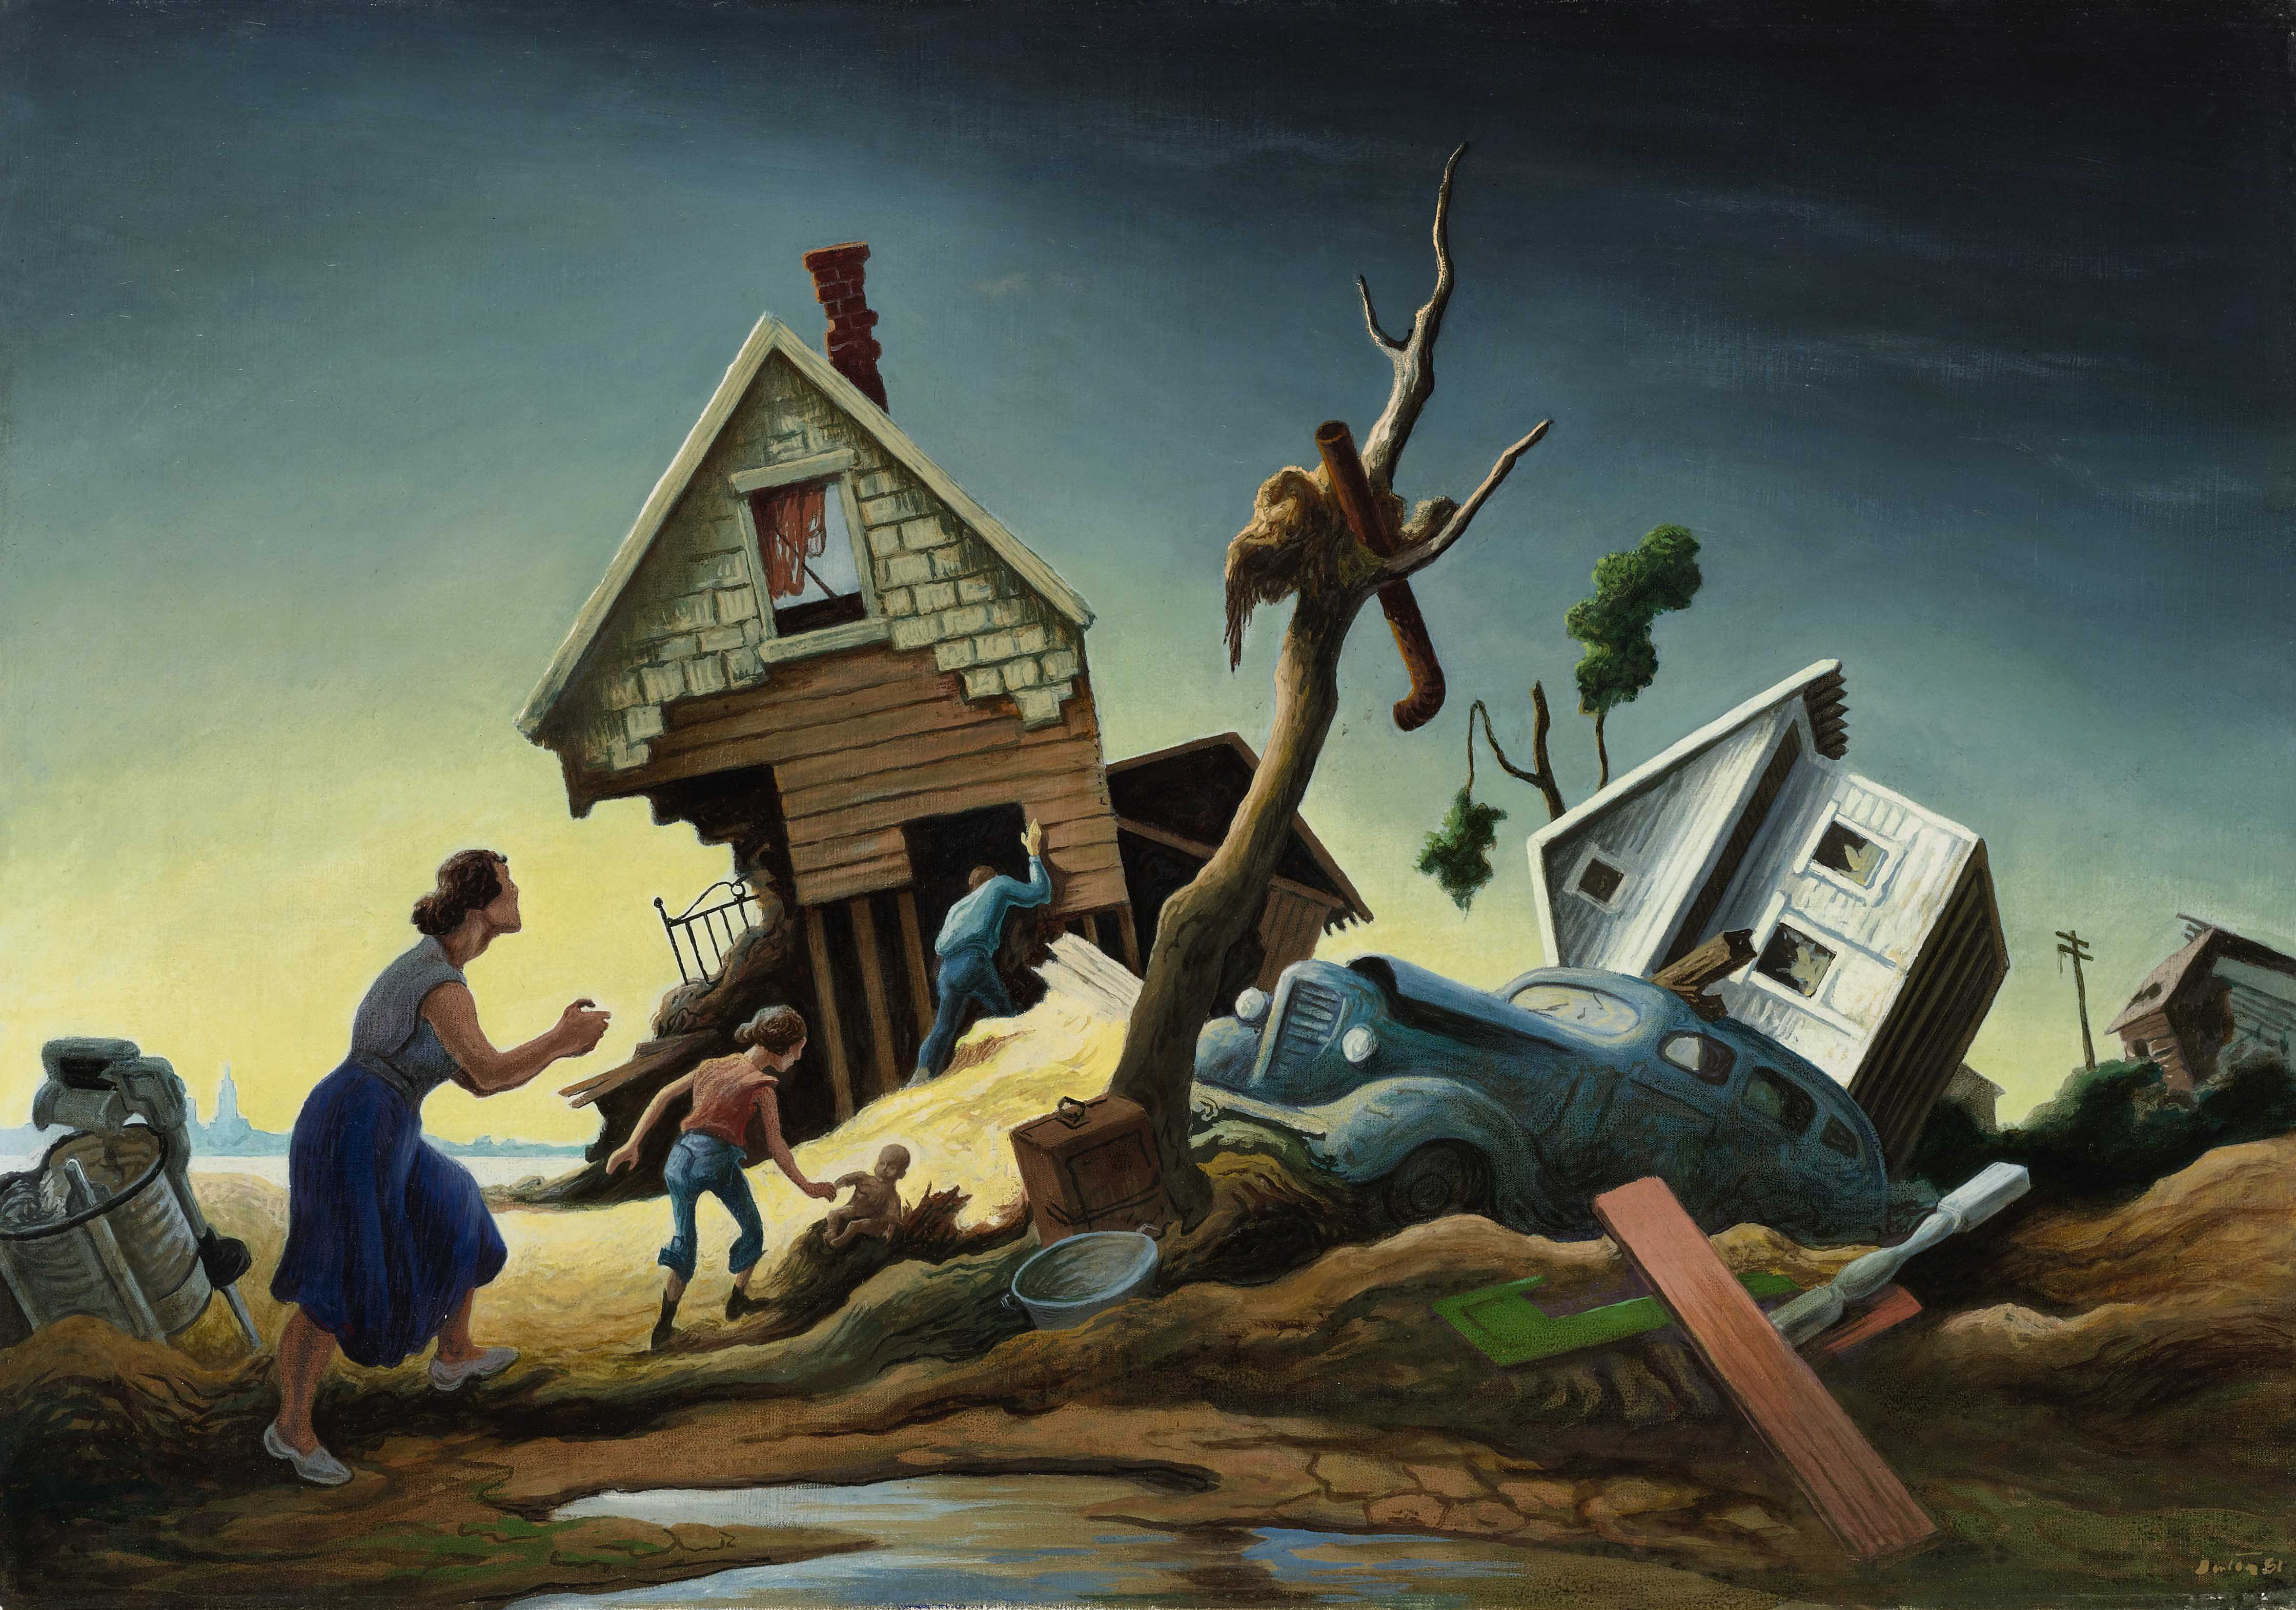
Prompt: What is happening in this visual text? Provide evidence from the text to support your claim.
TEACHER COLLECTS LANGUAGE SAMPLE SPF 1.0
STUDENT VISUAL TEXT
Notes:
Display the Student Visual Text
Direct students to use their Think Time
As the students play the game, the teacher listens and selects two students who will replay the game in front of the class to serve as models.
This is an opportunity to capture a language sample.

Slide 49
CONSTRUCTIVE CONVERSATION
FISHBOWL MODEL
PROMPT: What is happening in this visual text. Provide evidence from the text to support your claim.
Listen actively to what two partners say to each other.
FORMATIVE ASSESSMENT– TEACHER COLLECTS LANGUAGE SAMPLE SPF 1.0
Notes:
The two selected students will replay the game in front of the class and serve as models.
Student Progress Form (SPF)-­‐‑ Constructive Conversation Language Sample The teacher will collect a language sample from the two students on the Student Progress Form (SPF)-­‐‑ Constructive Conversation Language Sample to be used in Lesson 2. The language sample must be at least four turns in length. (Each turn includes both Partner A and B sharing

Slide 50
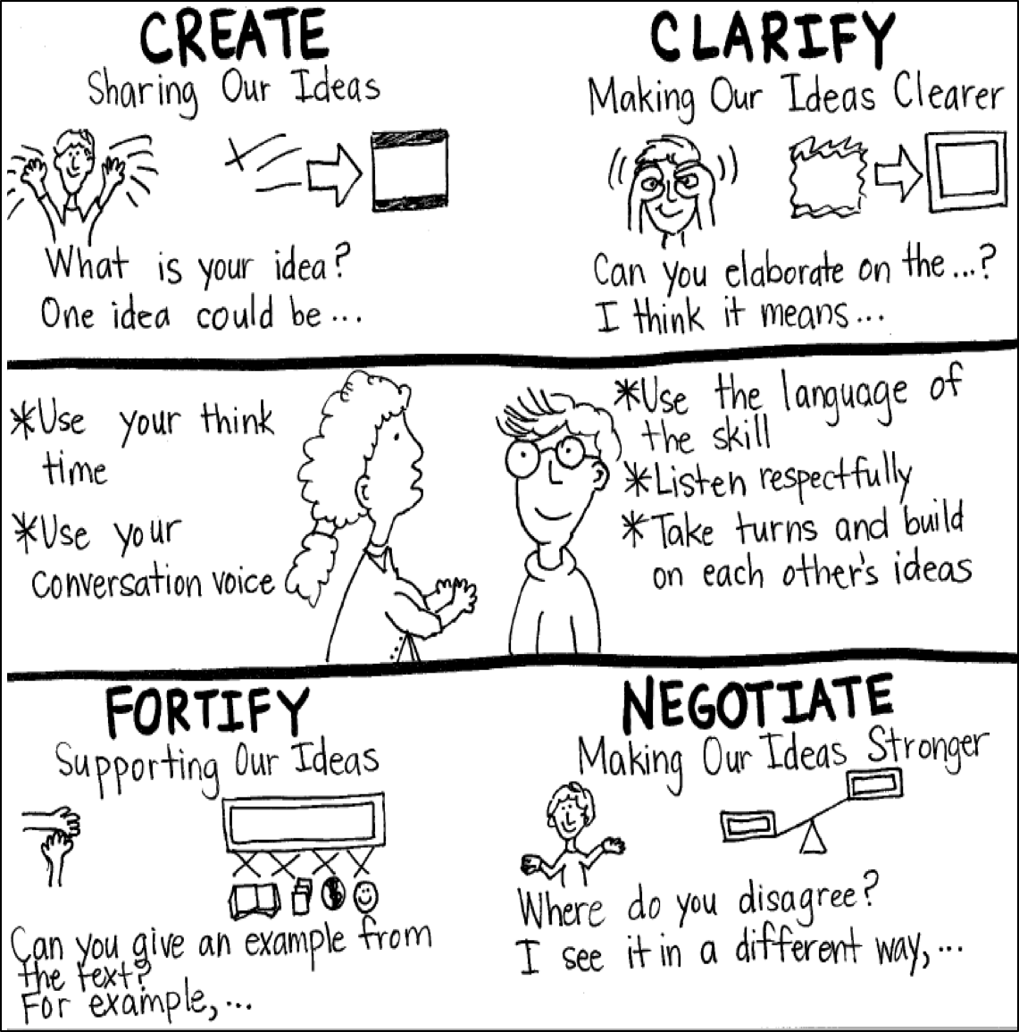
Model Creating Class Constructive Conversation Poster
Sample
Notes:
Teacher models creating a Constructive Conversation Poster. This slide is a resource. Teacher elicits student responses to help student develop a poster that illustrates their understanding of the FORTIFY skill and conversation norms.

Slide 51
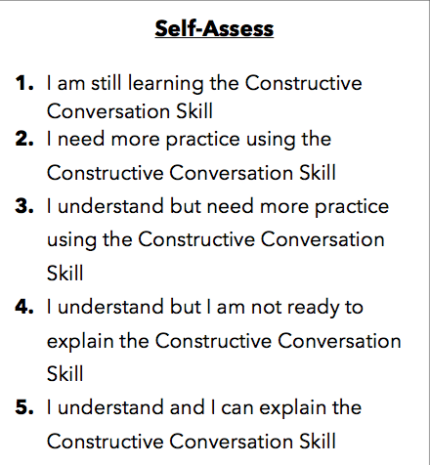
Notes:
Teacher will review the Constructive Conversation Skill FORTIFY
Students will self-assess answering the prompt
Teacher may select a conversation pair to share out.
EXAMPLE:
Student: I rated myself a 3 because…
Teacher: What can you do to move to a 4?

Slide 52
Teacher Resources

Slide 53
FORTIFY Non-Model Revision

